Slide 1
A Publisher’s Guide to Writing and Publishing Scientific Manuscripts
Presenters:
Mr Dean Eastbury, Executive Publisher, Elsevier, UK
Professor Ahmad Fauzi Ismail, UTM
18 February 2016

Slide 2
Scholarly Publishing An introduction
© Reed Elsevier Group PLC
Notes:
The goal of this part of the presentation is to provide authors with background information on academic publishing including the origins and roles of key stakeholders.
Slides will be made available to all attendees

Slide 3
The Publisher’s Role
March 2015
Registration
Certification
Dissemination
Preservation
Use
Innovation & Technology
© Reed Elsevier Group PLC

Slide 4
March 2015
Why Publish with Elsevier?
© Reed Elsevier Group PLC

Slide 5
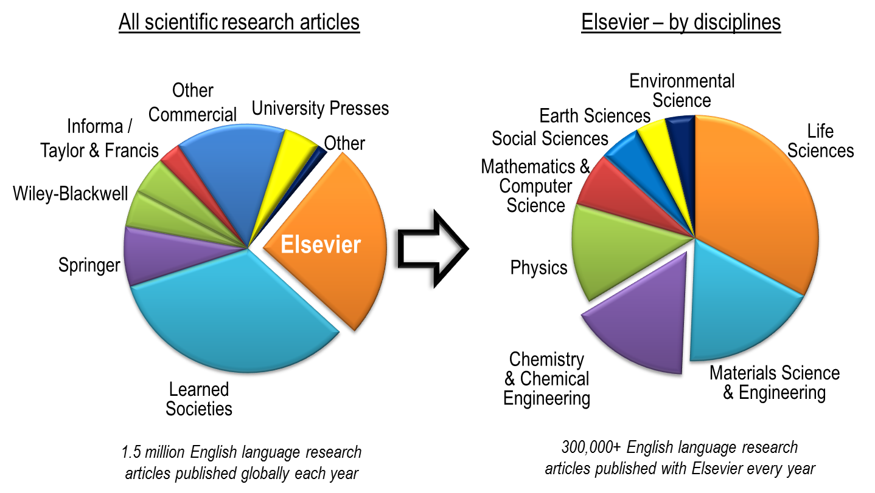
March 2015
Scientific Publishing Industry
© Reed Elsevier Group PLC

Slide 6
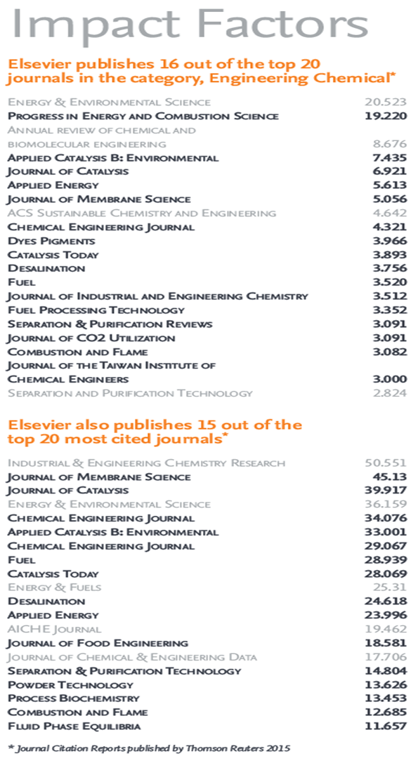
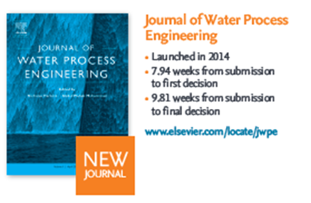
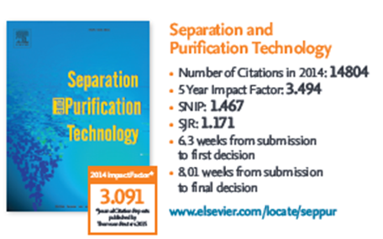
March 2015
© Reed Elsevier Group PLC

Slide 7
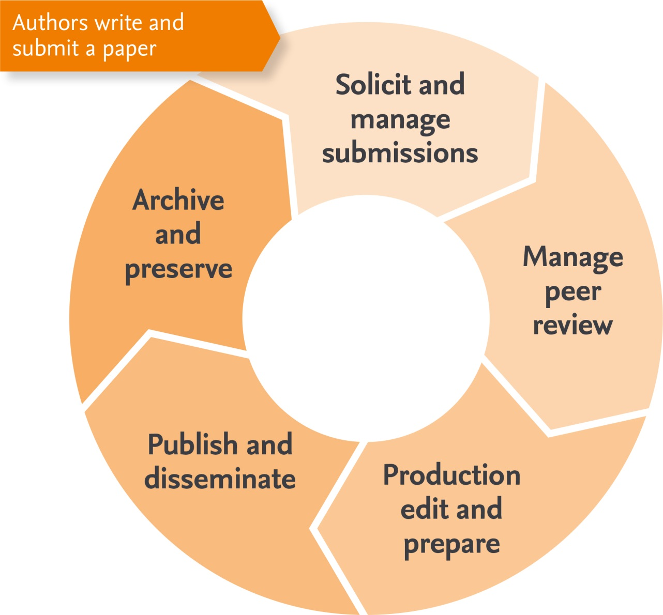
Academic publishing The publishing cycle
April 2015
557,000+
Referees
365,000+
Accepted papers
12.6 million
Articles available
700+ million
Downloads by
2,200
Scholarly peer reviewed journals
600,000+
Annual submissions
11+ million
Researchers in
40-80%
Rejected papers
13,000+
Editors
120+
Countries
© Reed Elsevier Group PLC
Notes:
Elsevier is a world-leading provider of information solutions that enhance the performance of science, health, and technology researchers, empowering them to make better decisions, deliver better care, and sometimes make groundbreaking discoveries, that advance the boundaries of knowledge and human progress. Elsevier provides web-based, digital solutions — among them ScienceDirect, Scopus, Elsevier Research Intelligence, and ClinicalKey — and publishes nearly 2,200 journals, including The Lancet and Cell, and over 25,000 book titles, including a number of iconic reference works. 12.6 million articles are currently archived in our system. Depending on the journal, on average 30-70% are rejected directly by one of the 13,000 editors they work with. Those articles that are not rejected upfront will undergo peer review. Currently they work with around 560,000 reviewers to evaluate these articles. Of these, around half get accepted after minor or major revision. Overall 365,000 articles are in the end accepted by the editors each year and “produced”, which means typeset, posted online, linked to the various external platforms like PubMed, promoted to the appropriate audience and of course archived for future use. 12.6 million articles are now available and have been downloaded over 700 million times, by 11 million researchers, across more than 120 countries.

Slide 8
Preparing your manuscript Before you get started
© Reed Elsevier Group PLC
Notes:
The goal of this part of the presentation is to provide authors with background information on academic publishing and outline the important steps you need to follow to prepare your manuscript for publication.

Slide 9
What makes a strong manuscript?
March 2015
A clear, useful and exciting message,
novelty
contribution
presented and constructed in a logical manner
allowing readers to easily grasp the significance.
© Reed Elsevier Group PLC

Slide 10
Types of manuscripts
March 2015
Full articles
Substantial, complete and comprehensive pieces of research
Letters or short communications
Quick and early communications
Review papers and Current Opinions
Often submitted by invitation
Micro Articles- NEW!
SoftwareX, MethodsX, Data in Brief
Your supervisor or colleagues are also good sources for advice on manuscript types.
© Reed Elsevier Group PLC
Notes:
There are various types of manuscripts that suit different purposes: Full Articles are the most frequent type. These are often substantial, complete, and comprehensive pieces of research that are of significance. Letters or Short Communications are quick and early communications of significant, original advances. These tend to be much more brief than full articles. Review Papers summarize recent developments on a specific topic, highlighting important points that have been previously reported and introducing no new information. These are often submitted after invitation by an Editor.
Methods X publishes the small but important customizations you make to methods every day.
Before selecting an article type for your manuscript, you should first self-evaluate your work. Ask yourself the following questions:
Is my message sufficient for a full article?
Are my results so thrilling that they should be shown as soon as possible in a short communication? Your supervisor or colleagues are also good sources for advice on manuscript type – Sometimes outsiders can see the situation more clearly than you.

Slide 11
Original Research Articles
Standard for disseminating completed research findings
Typically 8-10 pages, 5 figures, 25 references
Draft and submit the paper to appropriate journal
Good way to build a scientific research career
Sample Original Research Article Titles
“Hydrodynamic study of a liquid/solid fluidized bed under transverse electromagnetic field”
“Soluble nanoparticles as removable pore templates for the preparation of polymer ultrafiltration membranes”
“Kinetics of pressure oxidative leaching of molybdenite concentrate by nitric acid”
Notes:
The majority of our journal content - 90% is comprised of original research articles.
These full length papers are typically at least 10 pages in
which a hypothesis is formulated and tested, complete results are presented and a discussion is held to justify the results in comparison with
current literature.
As demonstrated in the sample titles, these articles tell a more complete story than a short communications or conference
article.
We will focus more specifically on constructing a full length research article in coming slides.

Slide 12
Short Communications
Quick and early communications of significant, original advances
Much shorter than full articles.
Sample Short Communications Titles
“A proposed rapid screening technique for new reverse osmosis membranes”
“Dispersion of particulate clusters via the rapid vaporization of interstitial liquid”
Notes:
Short communications or rapid communications are much shorter than full length articles.
As you can see from the sample titles provided, they are often “methods-based” where a previously established method is being used for a new application.
In this case, the method is not necessarily novel, just the application of the method.

Slide 13
Review Articles
Critical synthesis of a specific research topic
Typically 10+ pages, 5+ figures, 80 references
Typically solicited by journal editors
Good way to consolidate a scientific research career
Sample Review Paper Titles
“Polymeric membranes incorporated with metal/metal oxide nanoparticles: A comprehensive review ”
“Boron removal from saline water: a comprehensive review”
“A review of the beneficiation of rare earth element bearing minerals ”
Notes:
Review papers provide a very detailed overview of a particular research topic and as such are much longer and contain many more references than a traditional paper.
Review papers are typically solicited by our editors. We recognize that writing a review article requires a considerable amount of preparation, and want to be sure that the review topic is in alignment with the journal scope and strategy.
If you have an idea for a review article, feel free to contact the Editors or Publisher prior to writing. If we look at the sample titles, you will notice they are very broad, high level topics with ‘Review’ somewhere in the title. This is good to keep in mind when you are searching for review articles: typing ‘review’ in the search terms will help identify these comprehensive papers to start you on your way.
Review papers tend be cited more than original research articles so are both good for the author and have a positive effect on the journal’s impact factor.

Slide 14
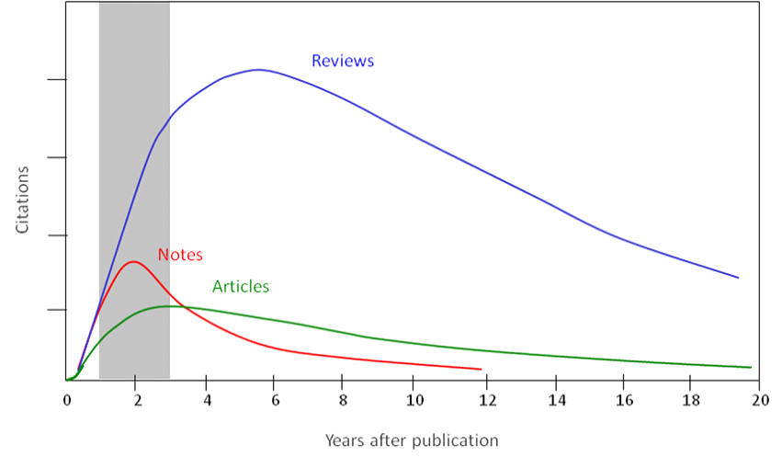
Citations per article type
March 2015
2014 Impact Factor =
2014 citations of papers published 2012 and 2013
# papers in 2012 + 2013
© Reed Elsevier Group PLC
Notes:
Citations for the different article types vary. This chart shows the difference in treatment and usage of article types. Review Papers tend to be much more highly cited and for a longer period of time than Full Articles or Short Communications.

Slide 15
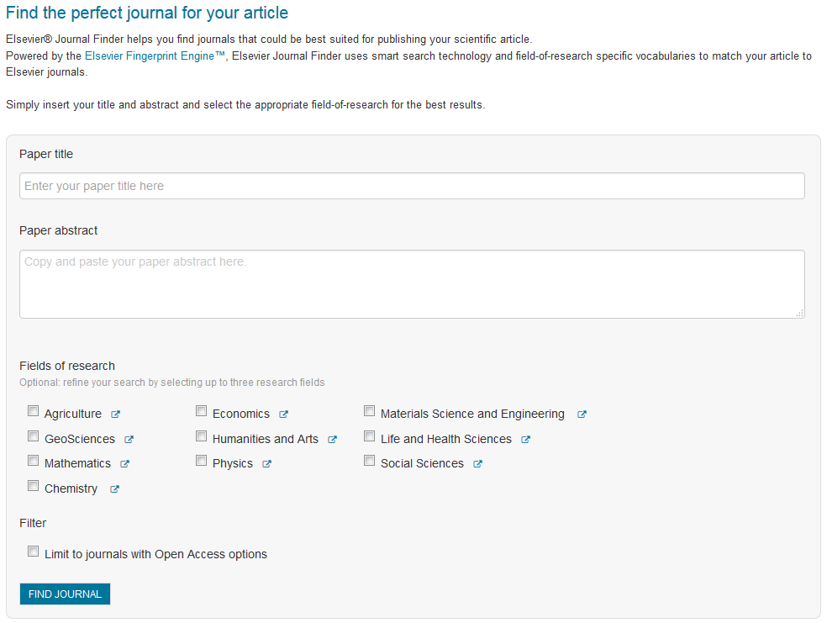
Choosing the right journal Journal Finder Tool (journalfinder.elsevier.com/)
March 2015
Articles in your references will likely lead you to the right journals for consideration.
© Reed Elsevier Group PLC
Notes:
For example, using Elsevier’s Journal Finder Tool, investigate all candidate journals on e.g. Elsevier.com to find out their Aims and Scope, Accepted types of articles, Readership and Current hot topics. You can do this by visiting their homepage on the publisher’s website and by going through the abstracts of recent publications. It is really important to select an appropriate journal so that your work will reach the intended audience.
If your paper is outside the scope of a journal, it will probably be rejected immediately by the editors because, not because of the quality of the work, but because the topic doesn’t fit with the journal.
Ask help from your supervisor or colleagues when you’re deciding where to submit - they may be more familiar with the different journals and your supervisor, who is often a co-author, has co-responsibility for your work.
It is very important that you DO NOT gamble by submitting your manuscript to more than one journal at a time. International ethics standards prohibit multiple or simultaneous submissions, and the editors do find out!
TIP: Articles in your references will usually lead you directly to the right journal.

Slide 16
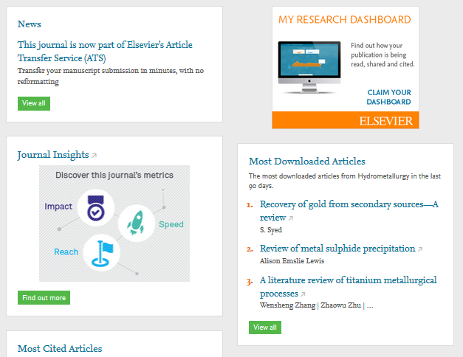
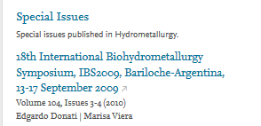
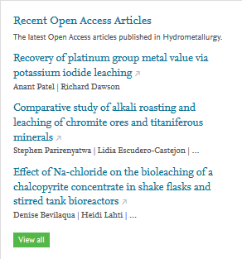
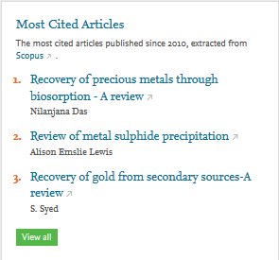
Choosing the right journal Consult the Journal Homepage
March 2015
© Reed Elsevier Group PLC
Notes:
For example, using Elsevier’s Journal Finder Tool, investigate all candidate journals on e.g. Elsevier.com to find out their Aims and Scope, Accepted types of articles, Readership and Current hot topics. You can do this by visiting their homepage on the publisher’s website and by going through the abstracts of recent publications. It is really important to select an appropriate journal so that your work will reach the intended audience.
If your paper is outside the scope of a journal, it will probably be rejected immediately by the editors because, not because of the quality of the work, but because the topic doesn’t fit with the journal.
Ask help from your supervisor or colleagues when you’re deciding where to submit - they may be more familiar with the different journals and your supervisor, who is often a co-author, has co-responsibility for your work.
It is very important that you DO NOT gamble by submitting your manuscript to more than one journal at a time. International ethics standards prohibit multiple or simultaneous submissions, and the editors do find out!
TIP: Articles in your references will usually lead you directly to the right journal.

Slide 17
March 2015
Recap: the steps I need to take
Determine
Decide
Choose
Check
© Reed Elsevier Group PLC
Notes:
To summarize the steps to take before even beginning to write your paper:
Determine if you are ready to publish your work by analyzing the significance of your achievements
Decide on the best type of manuscript: short communication, full original article, or review paper
Choose the target journal that is most appropriate and has the right level audience and prestige for your level of work
Check the Guide for Authors for your target journal and get details for the manuscript preparation.

Slide 18
Preparing your manuscript Using proper scientific language
© Reed Elsevier Group PLC
Notes:
The goal of this part of the presentation is to provide advice about the importance of using of proper scientific language in a manuscript.

Slide 19
Why is language important?
March 2015
It can delay or block publication of work
Proper English should be used
“It is quite depressive to think that we are spending millions in grants for people to perform experiments, produce new knowledge, hide this knowledge in an often badly written text and then spend some more millions trying to second guess what the authors really did and found.”
Amos Bairoch, Nature Precedings doi:10.1038/npre.2009.3092.1
© Reed Elsevier Group PLC
Notes:
It’s important to take seriously the presentation of your manuscript, especially the language you use to communicate your results. Without clear and proper language, editors and reviewers will not grasp the full message or impact of your work. Even though the findings you report might be cutting edge, poor language quality, including errors in grammar, spelling or language usage, could delay publication or could lead to outright rejection of the paper, preventing the research from getting the recognition it deserves.
Proper English should be used throughout the entire manuscript, and don’t forget the captions and headings in figures, charts, graphs, and photos.

Slide 20
March 2015
Do publishers correct language?
No! It is the author’s
responsibility...
...but resources are available
© Reed Elsevier Group PLC
Notes:
Authors often assume that the publisher will correct the language of their manuscript after it has been accepted, but this is not correct. It is actually the author’s responsibility to make sure a paper is in the best form possible.
Although Publishers do not correct language they do often provide resources for authors who are less familiar with the conventions of international journals. Please check your publishers’ author website for more information. Some publishers may also perform technical screening prior to peer review, and if the quality of the language of your paper doesn’t meet a journal’s minimum standards, it could be returned to you for improvement.

Slide 21
Manuscript language: Overview
March 2015
Accurate
Concise
Clear
Objective
© Reed Elsevier Group PLC
Notes:
The key to presenting your work well is to write clearly, objectively, accurately and
concisely. Foreign language students should practice writing English at any moment
they can, and even keep records in English during their research to practice their
language skills.
It’s obvious that you should try to prevent spelling errors by using a spell-checker in
English, but the other most common language errors involve:
Sentence construction
Incorrect tenses
Inaccurate grammar
Inconsistent use of English throughout the paper
You should always read the journal’s Guide for Authors to check for any additional
language specifications.

Slide 22
Manuscript language: Sentences
March 2015
An example of what NOT to do:
“If it is the case, intravenous administration should result in that emulsion has higher intravenous administration retention concentration, but which is not in accordance with the result, and therefore the more rational interpretation should be that SLN with mean diameter of 46nm is greatly different from emulsion with mean diameter of 65 nm in entering tumor, namely, it is probably difficult for emulsion to enter and exit from tumor blood vessel as freely as SLN, which may be caused by the fact that the tumor blood vessel aperture is smaller.”
Write direct and short sentences
One piece of information per sentence
Avoid multiple statements in one sentence
A possible modification:
“It was expected that the intravenous administration via emulsion would have a higher retention concentration. However, the experimental results suggest otherwise. The SLN entered the tumor blood vessel more easily than the emulsion. This may be due to the smaller aperture of the SLN (46 nm) compared with the aperture of the emulsion (65 nm).”
Read your manuscript out loud when proofreading.
You will pick up on more errors and run-on sentences.
© Reed Elsevier Group PLC
Notes:
To write a successful manuscript, first be aware of the sentence structure you use.
Sentences should be constructed in short, factual bursts.
Long and complicated sentences tend to confuse readers. Only one idea should be
conveyed in each sentence. The average length of sentences in scientific writing is only
about 12-17 words.
Rule of thumb: Typically more than 3 commas and you start to lose people. Each time you need to take a breath, should likely be a period.
Read your writing out loud when proof-reading your own text. Your eyes move faster than your brain, and you will miss more errors if you don’t read out loud.
Have a colleague, especially one who is not directly tied to your research, read your manuscript. If they can understand it, you have probably accomplished your goal.

Slide 23
Manuscript language: Tenses
March 2015
Present tense:
for known facts & hypotheses
Past tense:
for experiments conducted & results
© Reed Elsevier Group PLC
Notes:
You must also take care to use the proper tenses when describing your work and findings.
The present tense should be used for known facts and hypotheses, for example, “the average life of a honey bee IS 6 weeks.”
The past tense should be used for describing experiments that have been conducted and the results of these experiments, for example “The average life span of bees in our contained environment WAS 8 weeks…”
Being consistent and correct in your use of tenses makes your paper easier to understand for the reader.

Slide 24
Manuscript language: Grammar
March 2015
Use active voice to shorten sentences
Avoid abbreviations
Minimize use of adverbs
Eliminate redundant phrases
Double-check unfamiliar words or phrases
Passive: “CO₂ was consumed by the plant”
versus
Active: “the plant consumed CO₂”
© Reed Elsevier Group PLC
Notes:
Pay special attention to the grammar used in your manuscript. One way to help make
the work and results clearer for the reader is by using the active, rather than passive
voice.
The passive voice can be used in the Methods section of a paper but otherwise, the active voice will usually shorten sentences and make them more dynamic and interesting for the reader. You are encouraged to use the active phase “we found that…” freely, which is a quick signal to the reader that you are describing one of your results. This is also much more concise and to the point than writing in the passive voice, as in, for example, “it has been found that there had been…”
You should avoid contractions such as “it’s”, “isn’t”, or “weren’t” which aren’t often used in professional writing and avoid abbreviations except for very well known ones, unless you have clearly defined them within the paper.

Slide 25
Recap: Am I using proper manuscript language?
March 2015
Allows for an easy understanding of your work
Follow specifications in Guide for Authors
Use short sentences, correct tenses and correct English grammar
Have a native English speaker check your manuscript or use a language editing service
© Reed Elsevier Group PLC
Notes:
Language isImportant so editors and reviewers can easily understand the work
Refer to the journal’s Guide for Authors for specifications
Use short sentences, correct tenses, and correct English grammar
Have a native English speaker check your manuscript or use a language editing service
The purpose of publishing a manuscript is to communicate your message to the
research community. If your manuscript is poorly written or presented, in a way
which makes its message unclear, there is a risk that reviewers, editors, and
readers may not understand it. To ensure that your work is comprehensible, it is
essential that you use proper English language with concise sentences, correct
tenses, and correct grammar. Consult the journal’s guide for authors for any
additional specifications.
We also recommend that you ask a native English-speaking colleague to help you
edit the final version before submission, or take advantage of one of the many
language editing services available today.

Slide 26
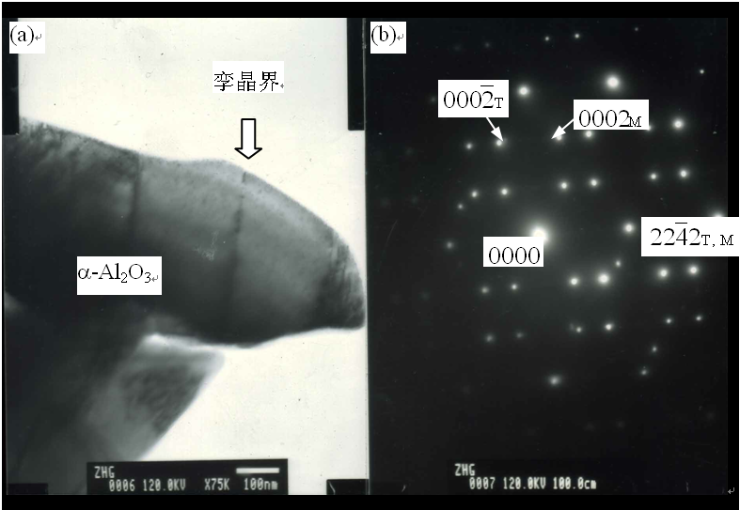
Language
Finally, you should use English throughout the manuscript, including figures!
Notes:
English language should be used throughout the entire manuscript.
This includes figures, charts, graphs, and photos.

Slide 27
Preparing your manuscript Structuring an article
© Reed Elsevier Group PLC
Notes:
The goal of this part of the presentation is to provide advice about how to properly structure your article.

Slide 28
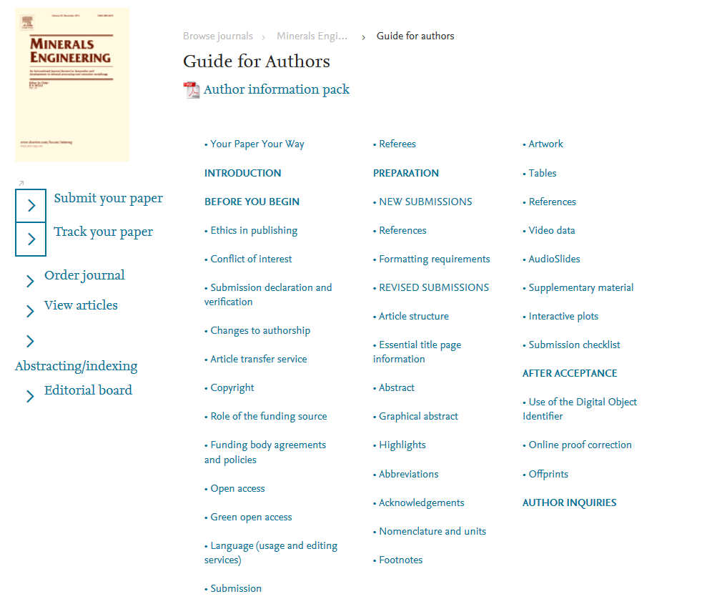
Guide for Authors
March 2015
Reference Simplification
Your Paper, Your Way
content innovation
© Reed Elsevier Group PLC
Notes:
Always consult the Guide for Authors
Each journal typically has a “Guide for Authors” with specific details for the
preparation of your manuscript. Apply the Guide for Authors to your manuscript,
even to the first draft (I normally print it out and have it sitting next to me while I
write). It can help you with the text layout, reference style, nomenclature, figures
and table and other important items. It will save your time and the editor’s.

Slide 29
General structure of a research article
March 2015
Title
Abstract
Keywords
Main Text (IMRAD)
Introduction
Methods
Results and
Discussion
Conclusion
Acknowledgements
References
Supporting materials
informative, attractive, effective
How do you search for a paper?
Make sure each section fulfills its purpose clearly and concisely
© Reed Elsevier Group PLC
Notes:
Manuscripts contain many sections and each one has a definite purpose.
At the beginning are the Title, Abstract, and Keywords which all play importantroles in allowing the article to be easily found, easily indexed, and advertised to potential readers. Make them easy for indexing and searching (informative, attractive, effective).
2. The main text of the article is summarized by the IMRAD acronym: Introduction, Methods, Results, AND Discussion. This is where you must present your work and convey the main messages and findings effectively. Reader’s time is not unlimited. Make your article as concise as possible.
3. The last group of sections bring up the end of the manuscript. The Conclusion, Acknowledgements, References and Supporting Materials. But these are just artificial groupings and the order can change. Some journals request the Discussion section to be combined with the Conclusion or Results. Others need it to be an independent section. There are also different arrangements of the order (e.g., Methods put after R & D…). Read the Guide for Authors for the specific criteria of your target journal.

Slide 30
The process of writing – building the article
March 2015
Title and abstract
Conclusion
Introduction
Methods
Results
Discussion
Figures/Tables (your data)
© Reed Elsevier Group PLC
Notes:
The sequence of writing the article is not the same as reading it.
For most scientific fields, the most efficient way is to regard the manuscript as a wall, building it brick by brick. You start with producing your tables and figures, with captions/legends.
Then describe the Method used, then the Results found and the Discussion around these results.
The Conclusion should flow on from this fairly easily.
Then you write the Introduction, as to where your work fits into the field as a whole.
Finally, the Title, Abstract and Keywords.
This process of building the article is easier, more logical and more effective that trying to write an article in the sequence it is read.

Slide 31
Effective manuscript titles
March 2015
A good title should contain the fewest possible words that adequately describe the content of a paper
Begin with the subject of the paper
Identifies main issue of the paper
Are accurate, unambiguous, specific, and complete
Are as short as possible
Does not use rarely-used abbreviations
© Reed Elsevier Group PLC
Notes:
There are certain characteristics of effective titles. They should:
Attract the reader’s attention
Contain the fewest possible words
Be specific and directly reflect the content of your manuscript
Be informative but concise
And they should not include technical jargon and abbreviations; use formal language
It is advisable to discuss the title with your co-authors.
Remember: Editors and reviewers do not like titles that make no sense or fail to represent the subject matter adequately. And maybe even more important, you want the appropriate audience to read your paper. If the title isn’t accurate, the right people may not read it and the community might be unaware of your work. This could even lead to lower citations than the paper deserves.
Do not contain rarely-used abbreviations.

Slide 32
March 2015
Original Title | Revised | Remarks
Preliminary observations on the effect of Zn element on anticorrosion of zinc plating layer | Effect of Zn on anticorrosion of zinc plating layer | Long title distracts readers. Remove all redundancies such as “observations on”, “the nature of”, etc.
Action of antibiotics on bacteria | Inhibition of growth of mycobacterium tuberculosis by streptomycin | Titles should be specific. Think to yourself: “How will I search for this piece of information?” when you design the title.
Fabrication of carbon/CdS coaxial nanofibers displaying optical and electrical properties via electrospinning carbon | Electrospinning of carbon/CdS coaxial nanofibers with optical and electrical properties | “English needs help. The title is nonsense. All materials have properties of all varieties. You could examine my hair for its electrical and optical properties! You MUST be specific. I haven’t read the paper but I suspect there is something special about these properties, otherwise why would you be reporting them?” – the Editor-in-chief
© Reed Elsevier Group PLC
Notes:
There are certain characteristics of effective titles. They should:
Attract the reader’s attention
Contain the fewest possible words
Be specific and directly reflect the content of your manuscript
Be informative but concise
And they should not include technical jargon and abbreviations; use formal language
It is advisable to discuss the title with your co-authors.
Remember: Editors and reviewers do not like titles that make no sense or fail to represent the subject matter adequately. And maybe even more important, you want the appropriate audience to read your paper. If the title isn’t accurate, the right people may not read it and the community might be unaware of your work. This could even lead to lower citations than the paper deserves.
Do not contain rarely-used abbreviations.

Slide 33
March 2015
Keywords
Are used by indexing and abstracting services
Are the labels of the manuscript
Should complement the keywords in the title
Use only established abbreviations (e.g. DNA)
Article title | Keywords
“Electrochemical bioleaching of high grade chalcopyrite flotation concentrates in a stirred bioreactor” doi:10.1016/j.hydromet.2010.05.001 | Acidophilic bacteria; Bioreactor; Chalcopyrite; Electrochemical bioleaching
© Reed Elsevier Group PLC
Notes:
Keywords are the labels or tags for your manuscript. Avoid words that have broad meaning - These should be specific enough to give someone a very quick idea about the content of your paper and are used by indexing and abstracting services.
Only use abbreviations that are firmly established in the field of study, e.g. DNA.
Check the Guide for Authors for specifics on which keywords should be used.

Slide 34
Abstract
March 2015
This is the advertisement of your article
A clear abstract will strongly influence
whether or not your work is considered
Make it interesting and understandable
What has been done?
What are the main findings?
Most publishers make the abstract freely available
Follow the Rule of 10
1-2 sentences: aim
2-3 sentences: materials & methods
2-3 sentences: results
2 sentences: discussion/conclusions
© Reed Elsevier Group PLC
Notes:
If the title catches a reader’s attention, the next thing they check is the abstract.
It is freely available in electronic abstracting & indexing services [PubMed, Medline, Embase, Scopus, WoS, etc...]
This should be a single paragraph summarising the problem, the method, the results, and the conclusions.
The abstract acts as an advertisement for your article since it is freely available via online searching and indexing. You want to make it as catchy and accurate as possible to have the greatest impact.
An abstract written clearly will strongly encourage the reader to read the rest of your paper.
Many authors write the abstract last so that it accurately reflects the content of the
paper. Take the time to write this very carefully.

Slide 35
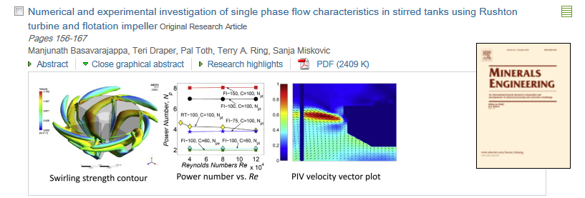
Graphical Abstracts and Research Highlights
March 2015
Graphical Abstracts
May be mandatory for your journal
Allows reader to grasp article content at a glance.
Examples: http://www.elsevier.com/graphicalabstracts
Research Highlights
3-5 bullet points to convey the core findings of the article
Maximum 85 characters (including spaces) per bullet point
Visit http://www.elsevier.com/highlights for examples
© Reed Elsevier Group PLC
Notes:
Some of our journals will require the submission of graphical abstracts and/or research highlights. Consult the Guide for Authors for instructions and specifications for submission.
A Graphical Abstract is a visual representation of the major finding of your article. Graphical abstracts appear on ScienceDirect under the title of your paper. The goal of a graphical abstract is to further entice readers to open and read your article. Graphical abstracts can simply be a key figure from your paper, or a ‘custom’ image that more appropriately depicts your novel experimental design or a summary of multiple findings/figures.
As an aside, Elsevier does provide illustration services through our webshop to assist you with your more complex artwork needs (there is only so much one can create on PowerPoint or Adobe Illustrator).
Highlights are 3-5 short bullet points which can be used to describe the core findings of the article. It differs from the abstract in that the highlights just focus on the major results/findings as opposed to a complete overview of the introduction/aim, materials/methods, and results/discussion/conclusions

Slide 36
Introduction
March 2015
You are telling a story. Introduction sets the scenario.
Do not attempt to summarize the whole field (it is not possible!)
Quote what is necessary for background and to give credit to previous works. Do not add superfluous references.
Editors may choose reviewers from cited work
Introduction is especially important!
A high proportion of “lack of novelty” rejections are made after reading the abstract, introduction and conclusions.
© Reed Elsevier Group PLC
Notes:
The Introduction is used to provide context for your manuscript and convince readers why your work would be useful in advancing that particular field of study.
Be brief in your introduction.
Long introductions may put readers off; try not to make this section into a history lesson.

Slide 37
Introduction (continued)
March 2015
Give a clear motivation for the work. Explain why before explaining how.
Explain what is novel compared to what is already available in the literature
High level description of your approach. Why is it important? Why is it difficult?
What are the alternatives? Why is yours different or better?
What are the gaps and how are you going to fill them? What is your “silver bullet”?
At the end of the introduction the reader knows the problem and maybe the solution you propose
© Reed Elsevier Group PLC

Slide 38
Introduction Recap
March 2015
You are telling a story.
Introduction sets the scenario.
Provide a brief context to the readers
Address the problem
Identify the solutions and limitations
Indicate novelty of approach
Offer clear hypothesis and proposed solution
Do not attempt to summarize the whole field (it is not possible!)
What is your motivation?
What are the gaps in knowledge?
Why is your approach different or better?
How do you plan to fill the gaps?
At the end of the introduction, the reader should know the problem and the
solution you propose.
© Reed Elsevier Group PLC
Notes:
The Introduction is used to provide context for your manuscript and convince readers why your work advances a field of study.
Be concise in the introduction but give the reader enough information to understand why the work is important. Introductions of Letters can be shorter, sometimes only one paragraph. This section shouldn’t be a history lesson but you do need to introduce the main scientific publications on which your work is based. Cite a couple of original and important works, including recent review articles, to give the reader a sense of how your work fits into the literature. But, take care to not make citations to irrelevant references, including your own.
Make sure you clearly address the following: what is the problem you are ultimately trying to solve? Are there any solutions? If so, what is the best solution and what is it’s limitations? What is your work trying to achieve?
Provide a perspective that is consistent with the journal where you are submitting.
Typically the last few sentences of the introduction should clearly state the hypothesis or aim of the work being presented.
Though it can be tempting to re-use introductions from your previous papers on
similar studies, every paper should present a new result and the work should be
specifically motivated. This requires a unique introduction every time.

Slide 39
Methods
March 2015
Include detailed information. The reader should be able to reproduce the experiment.
Previously published procedures need not be described in depth:
Cite methods and note any changes to the protocol and/or
Provide detailed methods in Supplemental Material
Identify the equipment and materials used
Provide source and related product information (company, molec. weight, etc.)
Write out full chemical/biological compound names (followed by abbr.) then use abbreviations throughout paper
Make sure that all symbols are defined.
Describe how the problem was studied
© Reed Elsevier Group PLC

Slide 40
Ethics committee approval
March 2015
Experiments on humans or animals must follow applicable ethics standards
Approval of the local ethics committee is required and should be specified in the manuscript, covering letter or the online submission system
Editors can make their own decisions on ethics
© Reed Elsevier Group PLC
Notes:
If your work involves experiments on humans or animals, it must follow applicable ethics standards. E.g. most recent version of the Helsinki Declaration and/or relevant (local, national, international) animal experimentation guidelines.
Approval of a local ethics committee is required and should always be specified at this point in the manuscript, covering letter or the online submission system. However, even approval of a local ethics committee does not guarantee that the editors will also agree that the work was done in an acceptable manner.

Slide 41
Methods Recap
March 2015
Describe how the problem was studied
Include detailed information
Do not describe previously published procedures
Identify the equipment and describe materials used
Provide source and related product information
(company, molec. weight, etc.)
Write out full chemical and biological compound names first (followed by abbreviation).
Make sure that all symbols are defined.
Check Guide for Authors regarding formatting of ‘units’
© Reed Elsevier Group PLC
Notes:
The Methods section describes how you studied the problem.
It is important to be detailed - a knowledgeable reader should be able to reproduce the experiment.
Any previously published procedures should not be re-written in detail. Those can be noted in the References or described in the Supporting Materials sections.
Identify the equipment and materials used in experiments, along with their sources if there is the chance for variability of quality of these items. If the work is computational or theoretical, here you can describe code, computational, or analytical methods.

Slide 42
Results
March 2015
The main findings
Analytical description of data from experiments described in the Methods section.
Findings/data of secondary importance should be captured in Supplementary Materials
Minimal interpretation of results and/or comparison with literature unless the journal combines the Results and Discussion sections
Results of the statistical analysis
Figures and tables
You are telling a story.
Keep the narrative flowing, concise, well organized.
© Reed Elsevier Group PLC
Notes:
Moving on to the results section. This is where you describe the important results of your research.
The results section is a rather dry section, as you are ONLY presenting the analytical findings from your experiments – it should NOT contain any interpretation of the data or comparison with the literature as this belongs in the Discussion. The only exception to this rule, is if the journal combines both the results and the discussion sections. Refer to the guide for authors for this distinction.
Use the Supporting Materials section freely for data of secondary importance.
But do not attempt to “hide” data in the hope of saving it for a later paper, or split the results of one project into many papers. This dilutes the effect of the work, results in lower quality papers and you may lose evidence that re-enforces your conclusions.
Your text should refer directly to the tables and figures as they appear within the text as well as supplemental material if applicable.
Use sub-headings to keep results of the same type together – this will make it easier to review and read. Number these sub-sections for the convenience of internal cross-referencing. Decide on a logical order of the data that tells a clear and easy story to understand. Refer to the guide for authors for any particular formatting standards for sub-sections.

Slide 43
Results: Figures and Tables
March 2015
Figures and tables are the most efficient way to present results
Results should be presented in a non-redundant way
Captions and legends should be self-explanatory; figures should be able to stand alone
What is the take home point?
Maximize space; make sure final versions of figures can be easily read (watch use of legends)
Use consistent formatting between figures
Plots: labels, scale and symbols
Micrographs: scale bar, point out key features
© Reed Elsevier Group PLC

Slide 44
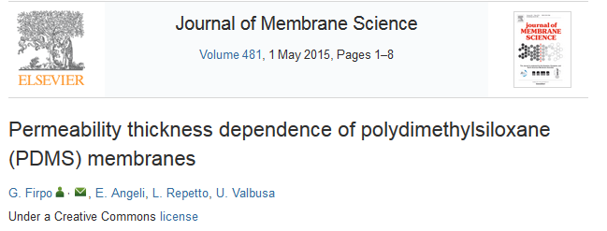
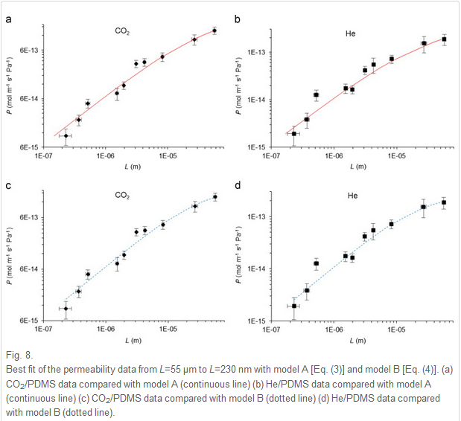
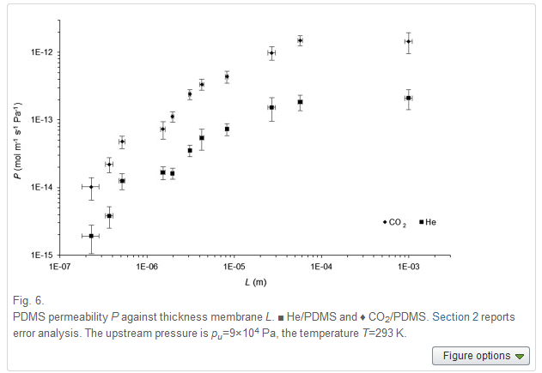
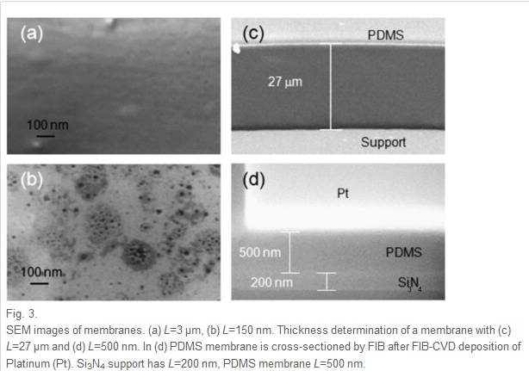
Results: Figures
March 2015
© Reed Elsevier Group PLC
Notes:
Illustrations, including figures and tables, are the most efficient way to present
the results. Your data are the “driving force of the paper”. Therefore, your figures
and illustrations are critical and they should be used for ESSENTIAL data only. The
legend of a figure should be brief and it should contain sufficient explanatory
details to explain the figure without the need to refer to the text. Use color ONLY
when necessary. If different line styles can clarify the meaning, don’t use colors or
other thrilling effects which can distract from the content and may not appear
when printed in black and white.
A. Graphs are often used to compare experimental results with those of previous works, or with calculated/theoretical values. Graphs should not appear crowded; try to present at most 3 to 4 data sets per figure. Use well-selected scales, label the axes clearly, use different symbols so that one can quickly discriminate between the data sets.
B. Tables often give the actual experimental results. Do not include long boring tables unless absolutely necessary (otherwise put them in the supplementary material), and make them as easy to read as possible.
C. Every photograph or image should be presented with a scale marker and the resolution should be clear.

Slide 45
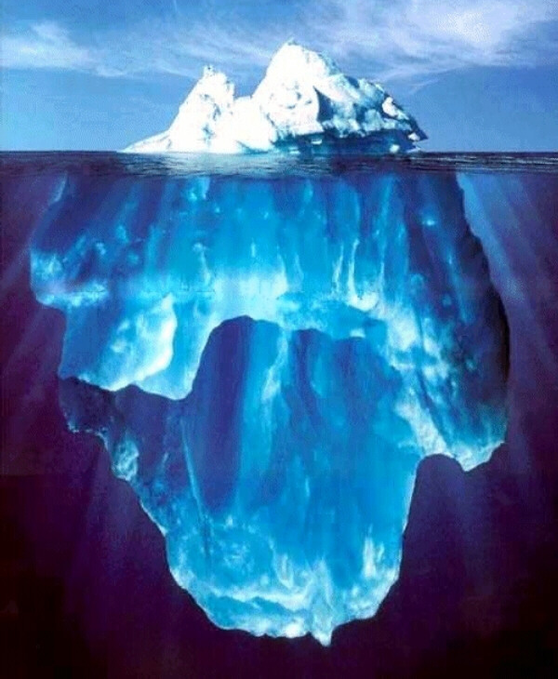
Results - Recap
March 2015
Be clear and easy to understand
Highlight the main findings
Feature unexpected findings
Provide statistical analysis
Include illustrations and figures
Do not try to fit everything in!
Analytical description of data with minimal interpretation of results and/or comparison with literature
This is not a thesis!
Contributed by Diego Gutierrez
© Reed Elsevier Group PLC

Slide 46
Figures and Tables – Recap
March 2015
Easy to read – maximize space
Consistent formatting between figures
Plots: labels, scale and symbols
Micrographs: scale bar, key features, image manipulations
Self-explanatory captions and legends – clear take home point
© Reed Elsevier Group PLC

Slide 47
Discussion
March 2015
Critical interpretation of results
Make the discussion correspond to the results
Do not make statements unsupported by your data.
Compare your results to published results
How does your data relate to the “big picture” or applications?
Can you identify a mechanism or form new hypotheses?
© Reed Elsevier Group PLC
Notes:
The Discussion is where you interpret what your results mean.
1. This is the most important section of the article. This is where you get the chance to SELL your data! A huge number of manuscripts are rejected because the Discussion is weak or only includes mere description of the results.
2. Make sure the Discussion corresponds to and compliments the Results, But do not simply repeat the results here.
3. Compare other published results with your own, And DO NOT ignore work in disagreement with yours – confront it and convince the reader that you are correct or better.
Be careful not to use the following:
- Statements that go beyond what the results can support
- Non-specific expressions such as “higher temperature” or “at a lower rate”; use quantitative descriptions instead
- The introduction of new terms not already defined or mentioned in your paper
- Speculations on possible interpretations are allowed. But these should be carefully explained and rooted in fact, rather than imagination.
If you need to revise the Results or Discussion this may involve a lot of work and require further experiments, derivations, or simulations. Sometimes you may not be able to clarify your idea just in words because some critical items have not been studied substantially – make sure your message is complete before you start writing or submit.

Slide 48
Conclusion
March 2015
Not the same as a summary!
Give conclusions that are supported by your results
Try to end in a positive tone
Do not overreach. Statements such as “this method can potentially be used…” do not belong to the conclusions (and often irritate referees)
Provide justification for the work
Relationship between the objective and key findings
Advance the present state of knowledge
Suggest future experiments
How the work advances the field from the present state of knowledge
© Reed Elsevier Group PLC
Notes:
The Conclusion is used to show how your work advances the field of study.
1. The conclusion should be clear to help the reviewers and editors judge your work and its impact.
2. Provide clear justification for how your work advances the field. This can be achieved by indicating uses, extensions, or applications of the work. Do not just repeat the abstract here. The Abstract and Conclusion serve different purposes although some of the same messages may be mentioned. Also, don’t list the experimental results here – trivial restatements of your results are unacceptable in this section.
3. Suggest future experiments that build on your work and point out any relevant experiments that may already be underway.

Slide 49
Acknowledgments
March 2015
Advisors and undergrad. support
Financial supporters and funders
Proof readers and typists
Suppliers who may have donated materials
Ensures those who helped in the research are recognized
© Reed Elsevier Group PLC
Notes:
The acknowledgments section is where you mention those who helped in the research but are not authors. This should be a single brief paragraph. Most often mentioned here are:
Advisors
Financial supporters/funders
Proofreaders
Typists
Suppliers who may have donated materials.

Slide 50
References
March 2015
Cite the main scientific publications on which your work is based
Do not use too many references
Always ensure you have fully absorbed material you are referencing
Avoid excessive self citations
Avoid excessive citations of publications from the same region
Conform strictly to the style given in the guide for authors*
* Some journals will format references for you!
© Reed Elsevier Group PLC
Notes:
The reference list is where you cite the main scientific publications on which you based your work. Take note that there are now some society journals that also require a “Conflict of Interest” statement to be placed before the References section.
Some tips for having a proper reference list are:
Do not include too many references, especially if they are only tangentially related to your work.
Always ensure that you have fully absorbed and understood the material you are referencing and do not just rely on reading excerpts or isolated sentences. Know what you’re referencing!
Avoid excessive self-citations of your own work or from a single region or institute.
4. Check the Guide for Authors to ensure the proper format. Presentation in the correct format is the responsibility of the author, not the Editor. Make the Editor’s work easier and they will appreciate the effort.

Slide 51
Authorship
March 2015
General principles for who is listed first
First Author
Generally conducts and/or supervises data generation
Sometimes puts paper together and submits to journal
Corresponding author
The first author or a senior author from the institution. Considered “mainly responsible” for the contents (but responsibility is shared!).
Somebody with a permanent e-mail address!
Sometimes puts paper together and submits to journal
© Reed Elsevier Group PLC
Notes:
The reference list is where you cite the main scientific publications on which you
based your work. Take note that there are now some society journals that also
require a “Conflict of Interest” statement to be placed before the References
section.
Some tips for having a proper reference list are:
Do not include too many references, especially if they are only tangentially
related to your work.
2. Always ensure that you have fully absorbed and understood the material you are referencing and do not just rely on reading excerpts or isolated sentences. Know what you’re referencing!
3. Avoid excessive self-citations of your own work or from a single region or institute.
4. Check the Guide for Authors to ensure the proper format. Presentation in the correct format is the responsibility of the author, not the Editor. Make the Editor’s work easier and they will appreciate the effort.

Slide 52
Authorship
March 2015
Corresponding author
First author
Good listing principle – spelling of names
Ghost authorship
Gift authorship
Poor listing procedure
The International Committee of Medical Journal Editors
(Vancouver Group) declared that an author must:
substantially contribute to conception and design, or acquisition of data, or analysis and interpretation of data;
draft the article or revise it critically for important intellectual content; and
give their approval of the final version to be published.
ALL 3 conditions must be fulfilled to be an author!
© Reed Elsevier Group PLC
Notes:
Determining the order of authors on a paper can vary by discipline and culture, but the general rule is that the first author is the person who conducts or supervises the data collection, analysis, presentation and interpretation of the results, and also puts together the paper for submission. The corresponding author can be the first author, or sometimes is a senior author from the institution.
You should always avoid ghost authorship, which means excluding authors who participated in the work, and gift authorship, which means including authors who did not contribute to the work. Be consistent in how you write the authors names.

Slide 53
Now that you think you have finished…
March 2015
Read the paper again and circulate to all co-authors. Be critical yourself and accept criticism from others.
Show it to your advisors
Try to be in the position of a reader/reviewer.
Forget what you know, read only what is written. Yes, it is difficult. Just keep trying.
If possible, have someone else you trust to comment on the paper.
If you need to explain something verbally, then you probably need to rewrite that part.
© Reed Elsevier Group PLC

Slide 54
Cover Letter – very important!
March 2015
Your chance to speak directly to the editors
Explain the main findings and motivation
Highlight novelty and significance of results
State final approval of all co-authors
State prior reviews, revisions, etc.
Note any special requirements
Referees: experts, not collaborators
State any conflicts of interest
© Reed Elsevier Group PLC

Slide 55
Cover Letter
March 2015
Final approval from all authors
Explanation of importance of research
Suggested reviewers
© Reed Elsevier Group PLC
Notes:
You’ve written and proof read your manuscript, and have provided a copy to ALL authors and have incorporated their edits. But before you can submit your manuscript, you must also prepare a cover letter.
The cover letter offers you a chance to correspond directly with the journal editor. Many editors won’t reject a manuscript only because the cover letter is bad. However, a good cover letter may accelerate the editorial process of your paper.
You want to mention what would make your manuscript special or worthwhile to the journal. Do not summarize your manuscript, or repeat the abstract. You should mention why your manuscript is original and what your purpose is.
Your letter should also state the final approval of all co-authors as well as if your manuscript has been previously rejected.
Make sure you have consulted the Guide for Authors for any special requirements such as conflicts of interest, suggested reviewers, people who should not review
Suggested reviewers should be experts in the field, not friends of the authors (no collaboration the past 3 years) or faculty from the same institute. Often journals ask for people in different countries, and it shouldn’t be board members of the journal (who are already in the reviewer pool of the journal). Remember that the purpose of peer-review is to ensure that you are publishing the “Best” science possible; it will ultimately benefit your research if you suggest referees who will be able to accurately assess, critically examine, and provide sound improvements for your work.

Slide 56
Peer-Review
© Reed Elsevier Group PLC

Slide 57
Understand the peer-review process
Author submits manuscript
Manuscript reviewed by Technical Screening for completeness and Language.
Reject
Make
decision
Editors
Revise
Evaluate based on SCOPE, NOVELTY, and QUALITY
Make decision
Make
decision
Reject
Peer - Review
Accept
Reject
Article Transfer System
Notes:
After submitting, the time it takes to hear from the Editor can vary depending on the journal. The average publication speed for Chemical Engineering journals is 20 weeks, with some taking as little as 14-17 weeks, and some taking much longer. This is in part dependent on our ease of identifying referees, and for these referees to provide their review in a timely manner. This also will be dependent on the amount of time you will take in any author corrections and proof approvals.
You will receive a decision from the Editor that the manuscript has been “Accepted”, “Accepted with Revision (minor or Major), or “Rejected”. If the article requires revision, you will be provided with the reviewers’ comments which you can use to make modifications and then re-submit your manuscript. If your manuscript is rejected, then you can note the suggestions from the Editor and re-evaluate if it is worth submitting your article to a different journal.
Your manuscript may also be rejected as being “out of scope” with the journal. In this case, the Editors may suggest an alternative journal that is more suitable, and in some cases, Elsevier may offer to transfer your manuscript to this recommended journal (it is your option to accept this ‘transfer’ or submit elsewhere).

Slide 58
Peer Review
March 2015
Helps to determine the quality, validity, significance, and originality of research
Helps to improve the quality of papers
Publishers are outside the academic process and are not prone to prejudice or favour
Publishers facilitate the review process by investing in online review systems and providing tools to help Editors and Reviewers
© Reed Elsevier Group PLC
Used with permissions.

Slide 59
Peer Review Decisions
March 2015
Rejection
Learn from feedback provided and improve work for re-submission
Minor Revision
Good job. Make the edits and resubmit quickly.
Major Revision
Answer comments, one by one, and explain changes made or not made
If you feel a remark is not justified or a request is unreasonable, say so, but substantiate your response.
Submit a revised version highlighting where changes have been made
© Reed Elsevier Group PLC
Notes:
Although revisions can be sometimes disheartening, try to remember that you have entrusted the editor and reviewers with the task of validating your work and making sure that you have presented the material in a clear, concise, and technically/experimentally correct manner. You are basically getting “free” advice and insight from some of the top researchers in the world.
In preparing a response letter take heed to:
copy and paste the reviewer comments and type your response below it
be very specific about the changes you made to the manuscript i.e. reference the page/line numbers where you inserted/deleted sentences, etc). Note that some journals will actually require you to show the edits within the text of the manuscript in a different colour.
If you strongly disagree with the reviewer, be POLITE with your rebuttal, and make sure you clearly re-explain/justify your methods/results/interpretations. Note that if they are “mistaken” it may be resultant of your poor explanation in the manuscript text.
Most importantly: you have spent months (if not years) in the lab doing the research, and have taken weeks (if not months) to write the manuscript. Cherish your work. If you didn’t believe in your research, you wouldn’t do it. Take the time to properly prepare and revise your manuscript as necessary. Make others just as excited about your findings as you are. Your contribution to the research community is necessary for driving research advances.

Slide 60
March 2015
After Acceptance
Be diligent with any last minute requests (e.g. quality of figures, format adjustments).
Return the proofs quickly. But make sure you revise them thoroughly (it is your last chance to correct any mistakes before your manuscript is published)
© Reed Elsevier Group PLC

Slide 61
March 2015
What leads to acceptance???
Attention to details
Check and double check your work
Consider the reviewers’ comments
English must be as good as possible
Presentation is important
Take your time with revision
Acknowledge those who have helped you
New, original and previously unpublished
Critically evaluate your own manuscript
Ethical rules must be obeyed
© Reed Elsevier Group PLC

Slide 62
Thank you

