Slide 1
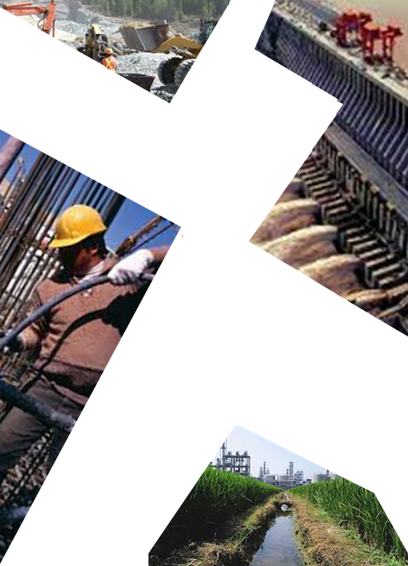
(Southern Branch)
Construction Research Centre (CRC)
CONSTRUCTION
Construction Research Centre (CRC)
(Southern Branch)
INDUSTRY &
ENVIRONMENTAL
& Solutions
ISSUES: Alternatives
One Day Short Course
Coordinators
Dr. Mohd Khairi Abu Husain
Siti Susiaty Maarof
UTM – CRC
Tel: 07-5531616, 019-7087076, 019-3682493
Email: ssusiaty@utm.my
mohdkhairi.kl@utm.my
Universiti Teknologi Malaysia
Construction Research Centre (UTM CRC)
UTM Razak School of Engineering and Advanced Technology
6.5 CPD Hours / 10 CCD Points
16 JUNE 2015
Design: mohammadaminazimi@yahoo.com
Venue
Dewan Seminar, Menara Razak, Universiti Teknologi Malaysia
Kuala Lumpur
UNIVERSITI TEKNOLOGI
MALAYSIA (UTM)
KUALA LUMPUR
www.utm.my/utmcrc
www.razakschool.utm.my
www.iemsb.org.my
www.cidb.gov.my
Designed by: mohammadamin azimi

Slide 2
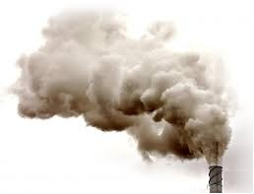
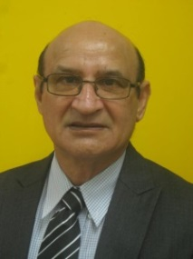
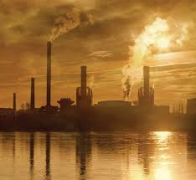
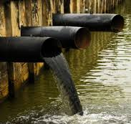
Course Description
The Course Recommended for
Scientists, academics, research scholars, students, consultants, engineers, Contractors
Ministries of environment, health, transportation, housing, Public works departments
Cement manufacturers
Industries involved in recycling waste materials
The objective of this short course is to enlighten the participants about the most current and applied research available on Construction Industry and Environmental issues. Alternatives and solutions involving minimal cement usage and maximized use of industrial/agricultural recyclable materials in green construction will be discussed. The presentations will include salient technical, energy-related, environmental, and economical advantages of using those materials in construction applications. The course should be of interest to those associated with construction industry, including design and material engineers, architects, engineering technicians, engineers working in governmental agencies, industry and private practice, engineering faculty and students, as well as ready-mixed concrete producers, concrete product manufacturers, and contractors. The course will also provide valuable insight to people from utilities and other industries producing recyclable materials. Knowledgeable Professor engaged in using those materials will present state-of-the-art information. Handouts will be provided.
Speaker Information
Dr. Jahangir Mirza, is a senior scientist from Research Institute of Hydro-Québec, Montreal, Canada. Presently, he is a Professor at UTM Construction Research Centre, Universiti Teknologi Malaysia, Johor Bahru, Malaysia. He is primarily involved in APPLIED R & D of materials and their application methods to repair, maintain and rehabilitate concrete structures, develop innovative ways of using natural, industrial and argo-
Topics Addressed
Concrete constituents and environmental impacts
Concrete properties
Causes of concrete deterioration
Effective use of recyclable materials for sustainable construction industry to reduce cost, energy, natural resources and GHG emissions
Surface repair materials for deteriorated concrete
Prof. Dr. Jahangir Mirza
-wastes to help decrease cost, energy and environmental problems of concrete industry.
Previously, Dr. Mirza also worked as an adjunct Prof. in the Civil Engineering and Applied Mechanics Department of McGill University, Montreal, Canada, for 8 years. He has authored and co-authored close to 180 technical reports and scientific publications and is a recipient of 16 national and international awards and honors from Canada, Malaysia, Pakistan, U.K. and USA. He is also a member of the Editorial and Advisory Boards of an international journal and conference respectively, as well as a former member of American Concrete Institute, International Concrete Repair Institute, Chemical Institute of Canada and Canadian Dam Safety Association. Dr. Mirza can communicate in 6 languages, namely, English, German, French, Hindi, Urdu and Punjabi.
Organizers
Registration Fee:
IEM members, RM300 Non IEM members, RM350 Students, RM150
Registration fee to be paid to CIMB BANK - (Account Number: 80-0605353-6)
BENDAHARI UNIVERSITI TEKNOLOGI MALAYSIA
Construction Research Centre, Universiti Teknologi Malaysia (CRC-UTM)
UTM Razak School of Engineering and Advanced Technology, Universiti Teknologi Malaysia
The Institution of Engineers, Malaysia (Southern Branch)

